Slide 1
IPv4 Address Subnetting
Lecture 17
CT4005NI - Computer Hardware and Software
Architectures

Slide 2
IP address
An IP address is a numeric identifier assigned to each machine on an IP network.
It is unique logical address that specifies where the device is on the network.
It is not hard-coded like mac-address i.e. it can change.
It has two types IPv4 and IPv6
172.16.0.12 192.168.1.1
2001:db8:3c4d:15::1a2f:1a2b

Slide 3
IPv4 (Internet Protocol version 4)
It is 32-bit address represented in decimal.
If we see 192.168.1.1 its
11000000.10101000. 00000001.00000001
It is divided into four octets.
Maximum value in one octet = 11111111 =255
Minimum value in one octet = 00000000 =0

Slide 4
IP Terminology
Bit: A bit is one digit, either a 0 or a 1.
Byte: A collection of 8 bits equals to 1 byte.
Octet: An octet is made up of 8 bits.
Network address: This is the designation used in routing to send packets to a remote network.
Broadcast address: The address used by applications and hosts to send information to all nodes/hosts on a computer network.

Slide 5
Subnet Mask
A subnet mask is a four-octet number used to identify the network ID portion of a 32-bit IP address.
eg: 255.255.255.0
In binary: 11111111.11111111.11111111.00000000
Network Part Host part
The part with 1’s is network part and with 0’s is host part.
It is written with IP address to indicate the network the IP is associated with.

Slide 6
Classes of IP address
Class | IP range | Subnet mask
Class A | 1.0.0.0 -126.255.255.255 | 255.0.0.0
Class B | 128.0.0.0 – 191.255.255.255 | 255.255.0.0
Class C | 192.0.0.0 -223.255.255.255 | 255.255.255.0
Class D | 224.0.0.0 -239.255.255.255 | Reserved for multicast
Class E | 240.0.0.0 -254.255.255.255 | Scientific research

Slide 7
CIDR value (Classless Inter Domain Routing)
CIDR value is the number of network bits in an IP address.
If 192.168.1.0/24 then /24 is the network bit/CIDR in the IP address.
so in binary: 11111111.11111111.11111111.0000000
and subnet mask: 255.255.255.0

Slide 8
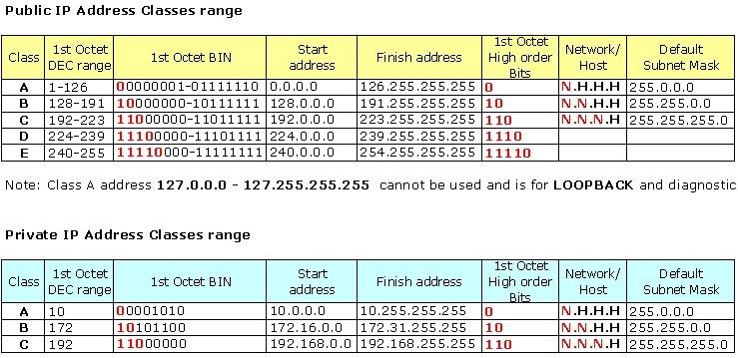
Network Addressing

Slide 9
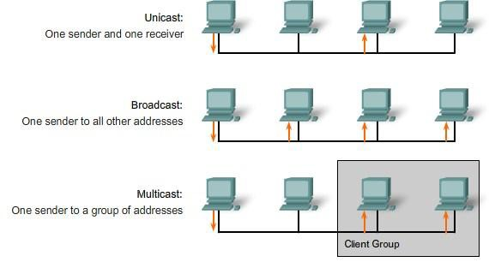
Unicast, Broadcast and Multicast

Slide 10
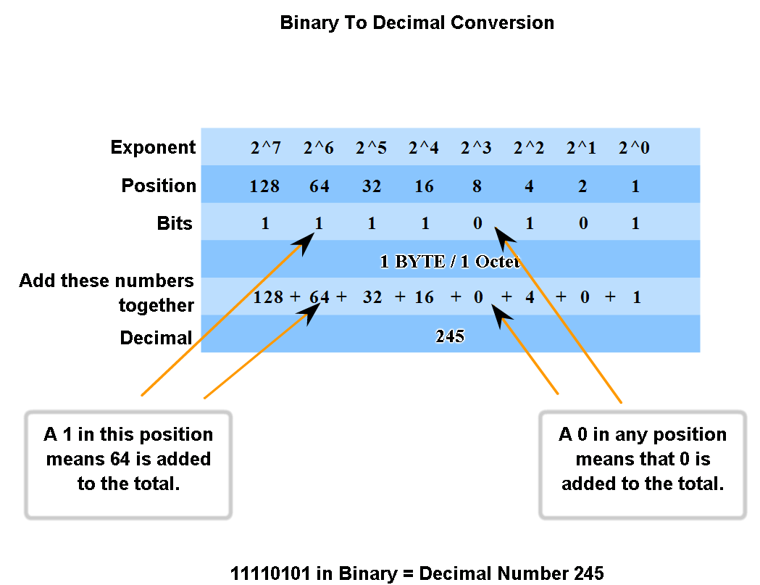
Binary to Decimal Conversion

Slide 11
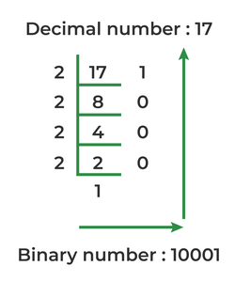
Decimal to Binary Conversion

Slide 12
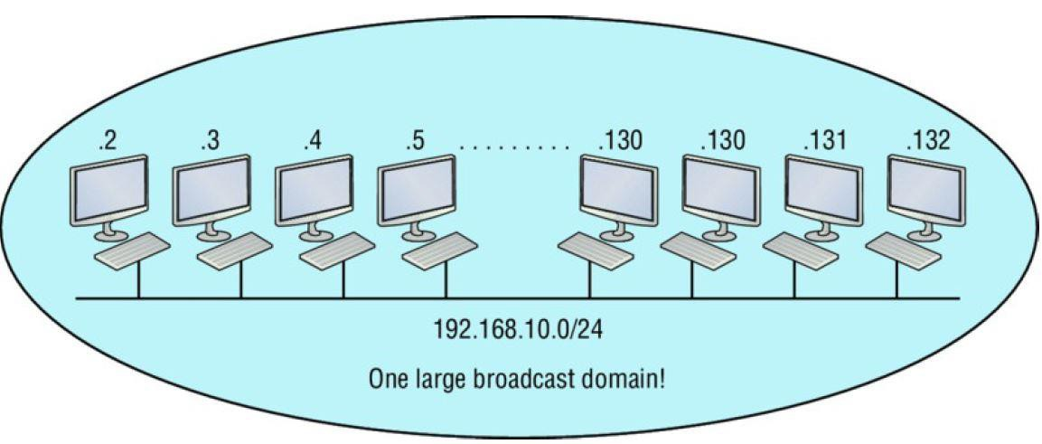
Problems with a single network

Slide 13
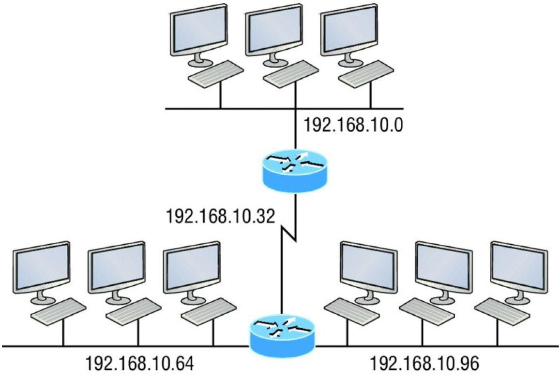
Subnetting
The process of breaking down a single big broadcast domain into a
bunch of smaller ones.

Slide 14
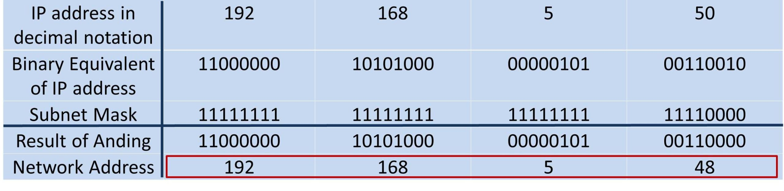
Network Address
The network address is a unique address to identify the network portion of the IP network
It is the first IP of the network.

Slide 15
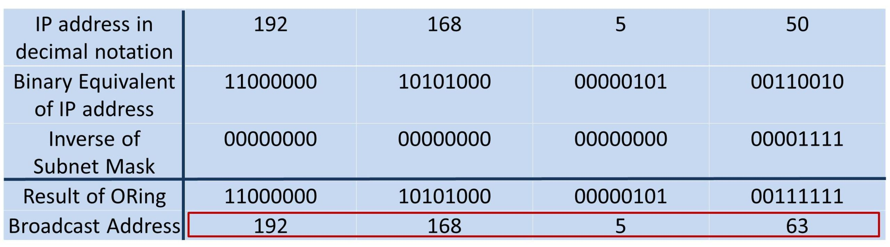
Broadcast Address
A broadcast address is used to send broadcast messages on the network.
It is the last IP of the network.

Slide 16
Example: Solve 10.2.32.254/18
Binary Subnet mask: 11111111. 11111111.11000000.00000000
Subnet mask : 255.255.192.0
No of IP’s : 2^14=16,384
No of usable IP’s: 2^14 -2=16,384-2=16,382
Network ID: 10.2.0.0
Broadcast ID: 10.2.63.255
Usable range: 10.2.0.1 – 10.2.63.254

Slide 17
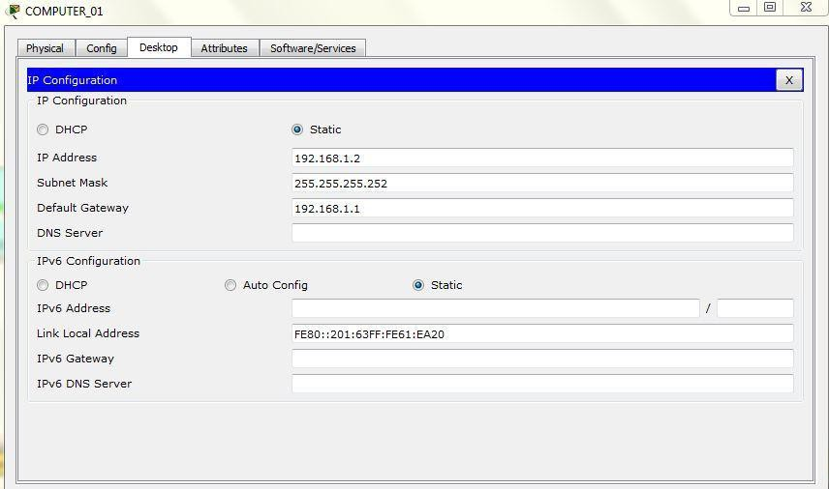
On the End Devices
CONFIGURING COMPUTER_01 in the network topology:

Slide 18
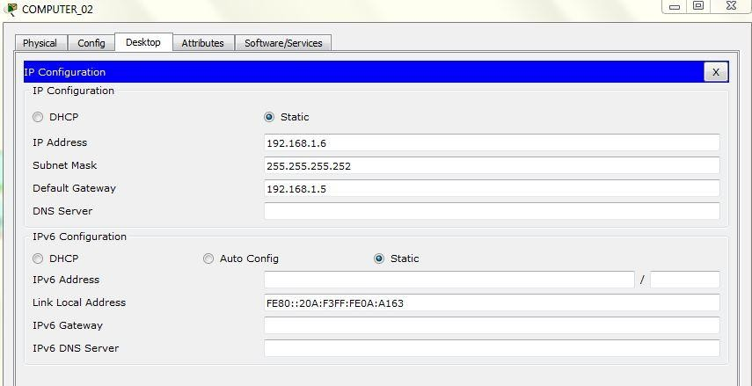
On the End Devices
CONFIGURING COMPUTER_02 in the network topology:

Slide 19
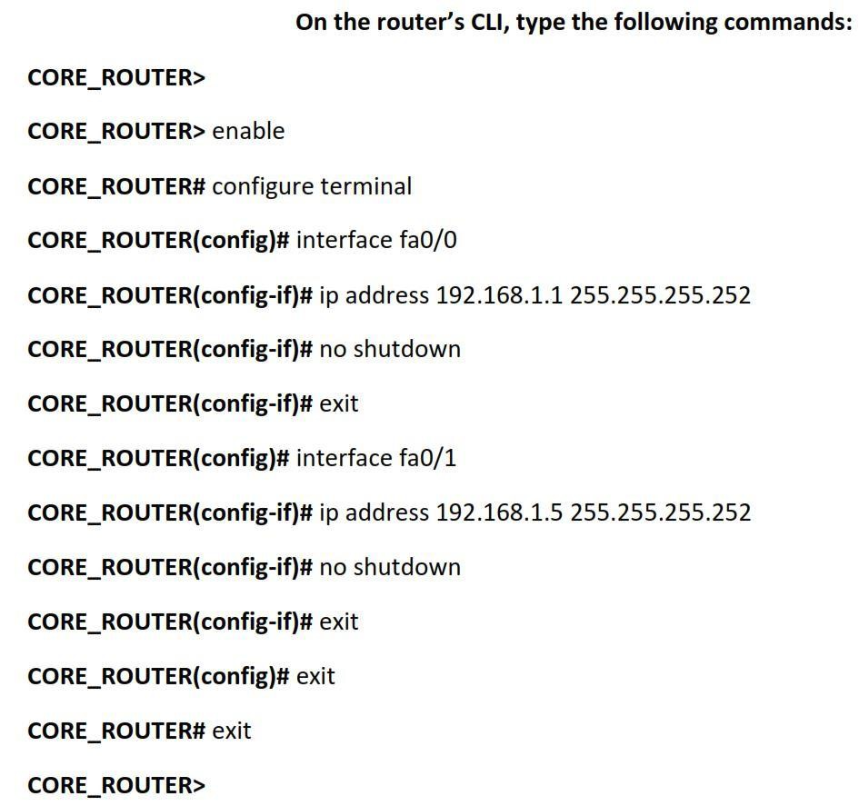
On the Router

Slide 20
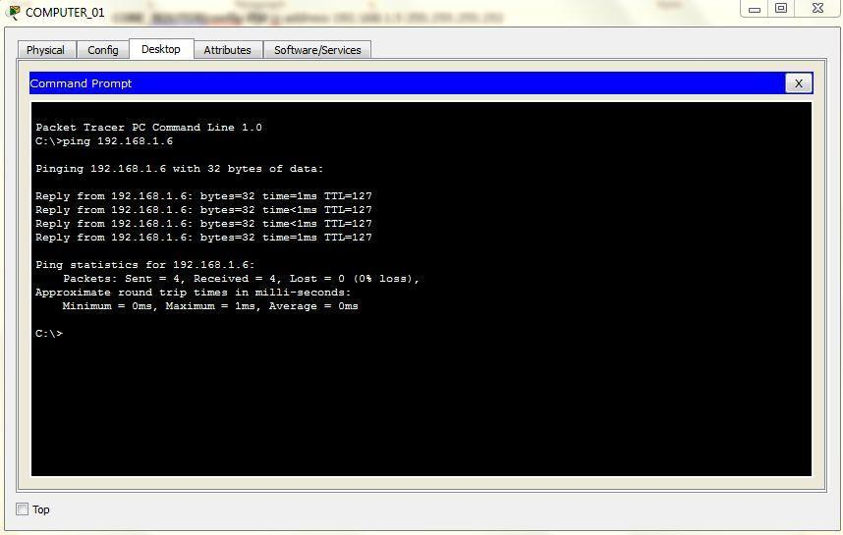
Testing the Subnets
Pinging Computer_02 from Computer_01

Slide 21
HAVE A NICE DAY

